Slide 1
Bulk Transport: Exocytosis & Endocytosis
Lecture 12

Slide 2
Objectives
Understand/know/focus on/note
what a vesicle is and how it has multiple purposes
the mechanisms and purposes of
endocytosis
exocytosis
phagocytosis
pinocytosis
receptor-mediated endocytosis
examples of how these processes occur in human cells

Slide 3
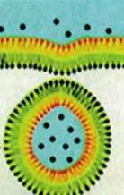
Vesicles in Cells
Vesicles are membranous containers
The membrane is the same phospholipid bilayer that makes up all membranes
The membrane proteins may differ from those on the cell surface (the plasma membrane), unless the vesicle is being prepared for becoming part of the plasma membrane
The inner contents of a vesicle can vary greatly, depending on the fated function of the vesicle

Slide 4
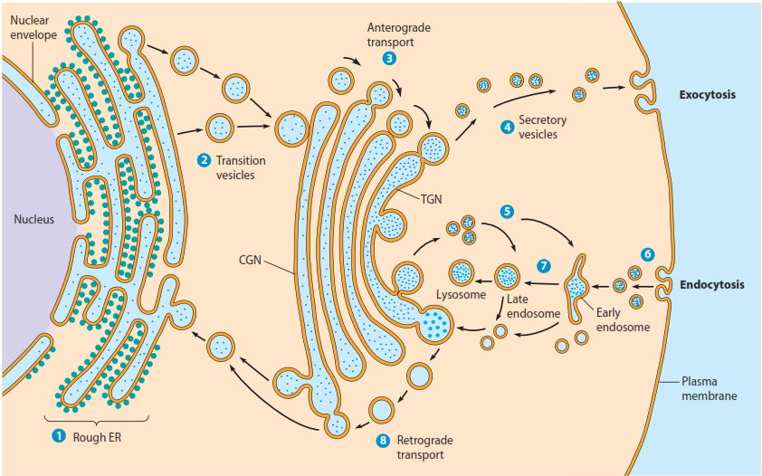
Vesicle Formation & Fusion
The proteins and phospholipids that make up the plasma membrane start forming in the endoplasmic reticulum (ER), a network of flattened membranous sacs. The ER may be associated with ribosomes, where protein synthesis is occurring
Vesicles form off the ER and move to another series of flattened membranous sacs called the Golgi complex, where
particularly glycoproteins will get modified with their oligosaccharides
Some vesicles will eventually make their way to the surface of the plasma membrane and fuse with it

Slide 5
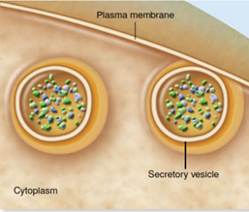
Exocytosis 1 of 3
Exocytosis refers to any process in which the cell forms a system for expelling or secreting contents from within its cellular container
In exocytosis, the inner space of the vesicle will fill with a substance that is to be secreted from the cell
For example, neurons produce vesicles containing neurotransmitters such as acetylcholine or epinephrine
As the vesicle matures with the filling of its space, it approaches the surface of the plasma membrane and makes contact with it

Slide 6
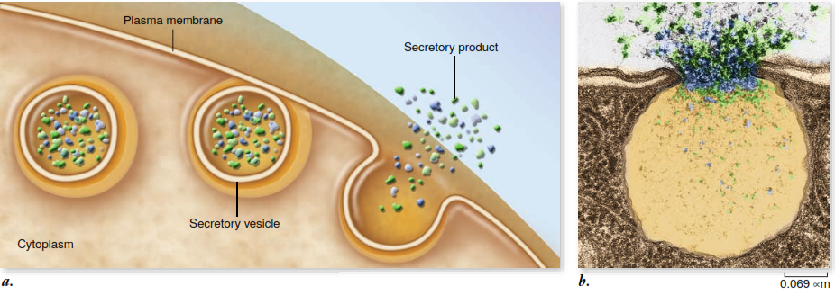
Exocytosis 2 of 3
A signal will then be transmitted to the plasma membrane
for neurons, it can be an action potential
The signal will then cause Ca²⁺ channels on the plasma membrane to open
with Ca²⁺ levels higher outside of a cell then inside, Ca²⁺ rushes in
In neurons, the Ca²⁺ channels can be triggered by membrane voltage: voltage-gated Ca²⁺ channels

Slide 7
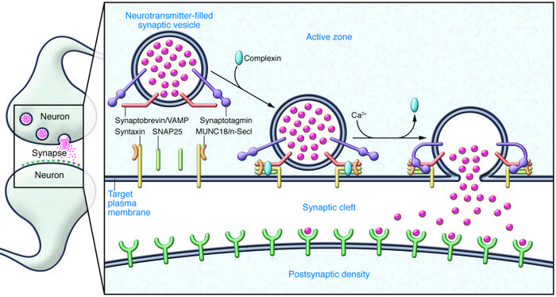
Exocytosis 3 of 3
The increased Ca²⁺ then starts a chain of events that make the membranes of the vesicle fuse with the plasma membrane, and the chemical contents of the vesicle are released to the outside of the cell
The figure at left shows a lot of the molecular details of Ca²⁺-mediated vesicle fusion in a neuron that are known but beyond the scope of this course

Slide 8
Endocytosis
Endocytosis is about the cell using a process in which the cell membrane invaginates, enclosing something from the extracellular medium within the invagination, and then fusing the plasma membrane to form a vesicle
3 Types
phagocytosis
pinocytosis
receptor-mediated endocytosis
also referred to as adsorptive pinocytosis

Slide 9
Phagocytosis
Cells "eating" large particles
Cell engulfs large or solid material (> 0.5 µm)
clump of bacteria, cell debris, inanimate particles (e.g. asbestos fibers or glass)
Lower animals use this process for their nutrition
e.g. protozoa, sponges, flatworms
Phagocytic cells in humans are neutrophils and macrophages
not used for nutrition, but rather body defense against bacteria, foreign substances, and eliminating debris from dead cells

Slide 10
Phagocytosis Overview
Phagocytes (cells capable of phagocytsis) move by an ameboid motion in which cytoplasm flows into cell membranes to cause membranes to envelop target
This happens in response to the target activating cell receptors
The cytoplasmic extensions are called pseudopods
pseudo: sham, mock, deceptive, ersatz; podia: feet
A vesicle forms around the target called a phagosome
The phagosome fuses with a lysosome to form a phagolysosome
The phagolysosome vesicle activates H⁺-transporting membrane proteins that pump H⁺ from the cytosol into the vesicle interior, greatly acidifying it

Slide 11
Phagocytosis Mechanism 1 of 2
Cell membrane folds around particle to form food cup
Membrane invaginates and folds extend further around the particle
Eventually the particle is completely engulfed
Membrane pinches off to form a free phagocytic vacuole in cytoplasm
Phagocytic vacuole moves towards Golgi region
Phagocytic vacuole merges with a primary lysosome: this forms a secondary heterophagic lysosome

Slide 12
Phagocytosis Mechanism 2 of 2
The internal pH of lysosome is reduced by proton pumps in lysosomal membrane
At low pH (< pH 5) lysosomal enzymes are activated, and these digestive enzymes break down the particle into smaller molecules (destroying biological activity)
Undigestible waste may have any of these fates:
In lower organisms, it is excreted by exocytosis
In mammalian phagocytes, some stay in the cell and contributes to cell aging
Neutrophils may "eat until they burst" because they don't release old waste

Slide 13
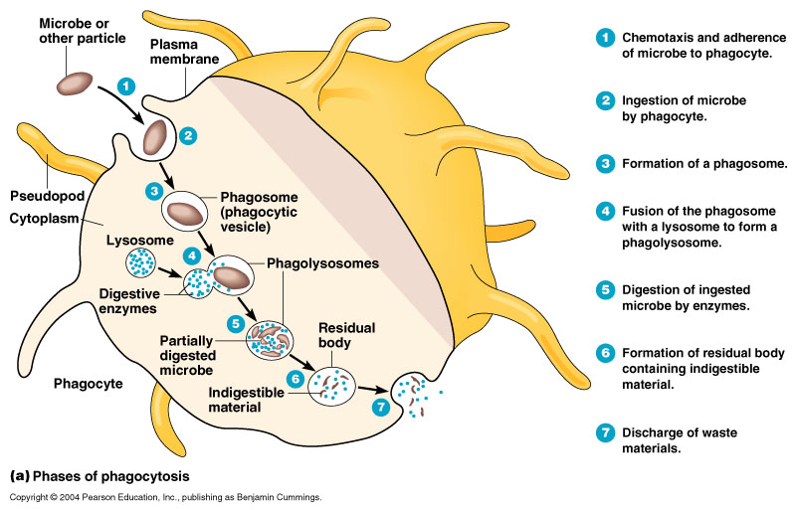

Slide 14
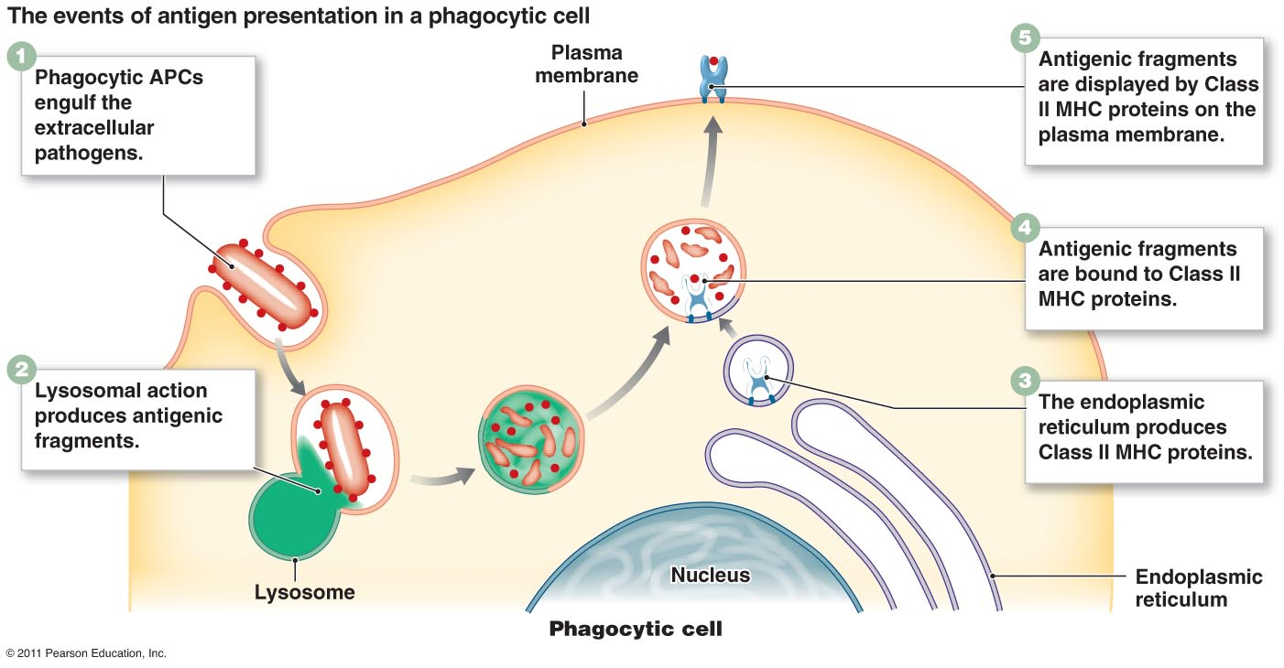
Macrophages Have Additional Function
Macrophages not only break down foreign material
Oligopeptide (short polypeptide) fragments (from 9-11 amino acids long) are allowed to bind to major histocompatibility (MHC) class II molecules and presented on the macrophage cell surface
If a T lymphocyte recognizes the MHC II-oligopeptide antigen complex, it gets activated, because the MHC II-oligopeptide antigen complex is foreign! This causes an immune reaction that builds up antibodies and also cytotoxic cells that recognize the complex
Self antigens don't activate T lymphocytes because all T lymphocytes that could recognize them were exterminated a long time ago during the development of the immune system

Slide 15
Pinocytosis
pino-: drinking; -cyt-: cell; -osis: condition of
also called fluid-phase endocytosis
Infolding plasma membrane surrounds very small volume of extracellular fluid containing dissolved molecules ("droplet"): droplet enters the cell
Pinocytosis is a routine activity of most cells, because they sample extracellular fluid in nonselective way
Intestinal epithelial cells use pinocytosis a great deal in order to absorb nutrients
Pinocytic vesicles are returned to surface after contents absorbed intracellular to restore membrane phospholipids

Slide 16
Pinocytosis Mechanism
Macromolecules bind to general receptors on plasma membrane
Membrane invaginates, drawing particles into a "cupped" region
Different from a phagocytic "food cup" because there are no externally projecting folds
Cupped region becomes completely enclosed by invagination
Pinches off to form a free pinocytic vesicle within the cytoplasm

Slide 17
Pinocytosis
Two outcomes have been observed
micropinocytosis
pinocytic vesicles may fragment into smaller vesicles
Ingested molecules are transported to lysosomes by the small vesicles, which have been called endosomes in the most recent studies
macropinocytosis
pinocytic vesicles may coalesce to form larger vesicles
This usually happens during transcellular transport, e.g. GI epithelial cells. The final stages of pinocytosis are not understood completely.

Slide 18
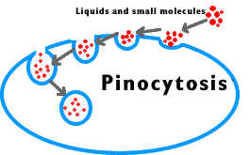
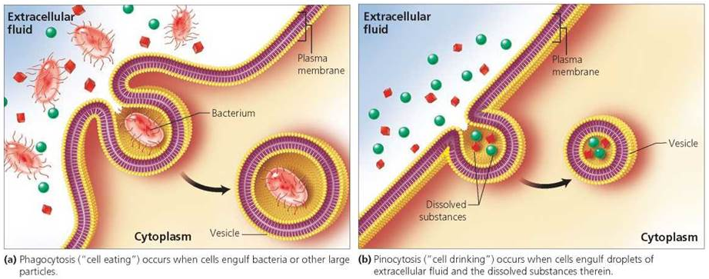
illustration below shows difference between phagocytosis & pinocytosis

Slide 19
Receptor-Mediated Endocytosis
Also called adsorptive pinocytosis
Allows cells to concentrate material present only in small amounts in extracellular fluid
Uses specialized membrane receptors (as seen in cell signaling) that target molecules outside cell
Process leads to membrane infolding to form vesicle with many accumulated target ligand molecules brought into the vesicle
On inside of cell, a scaffold of proteins of different kinds helps to form a vesicle: the scaffolding plus the pit are called coated vesicles or coated pits
NOTE: the receptors are NOT the scaffolding proteins!!

Slide 20
Receptor-Mediated Endocytosis Features
Identified scaffolding proteins
clathrin
caveolin (supposedly not widely accepted: status?)
Examples of receptor-mediated endocytosis
Receptors for low-density lipoprotein (LDL) collect & take in LDL particles, largely to obtain cholesterol
The iron (Fe³⁺)-carrying plasma protein transferrin (TRF) is taken in by the RME process for cells with TRF receptors
Pathogenic bacteria have adapted to make use of RME process in order to introduce their toxins into the cell: e.g. diphtheria toxin

Slide 21
Receptor-Mediated Endocytosis Mechanism
Ligand binds to specific receptors on the cell membrane, triggering internalization process
Ligand-receptor complexes move laterally within membrane to collect into forming coated vesicles
Endocytosis occurs in region of coated vesicle
Coated vesicle forms in cytoplasm
Coated vesicle may fuse with other vesicles which are not coated
The clathrin coat dis-assembles and proteins recycled back plasma membrane
Vesicle membrane has ATP-dependent proton pump that acidifies the vesicle: acidification causes ligand separation from receptors
Ligands are processed further to obtain substance (cholesterol, iron) for cell utilization. Receptors are recycled back to plasma membrane.

Slide 22
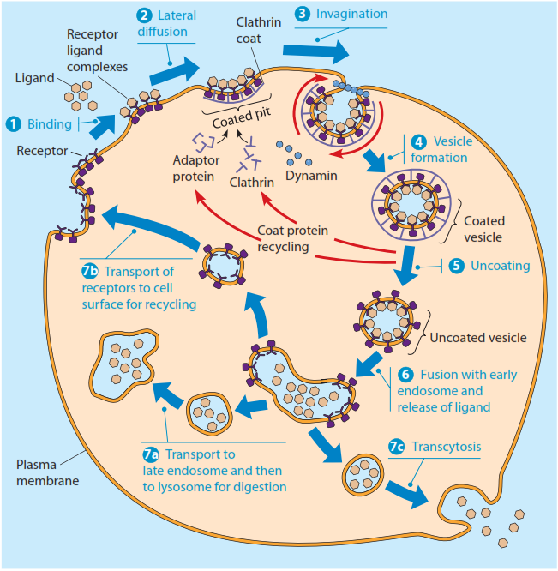
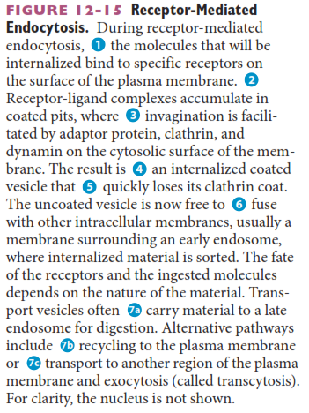
Becker, p 345

Slide 23
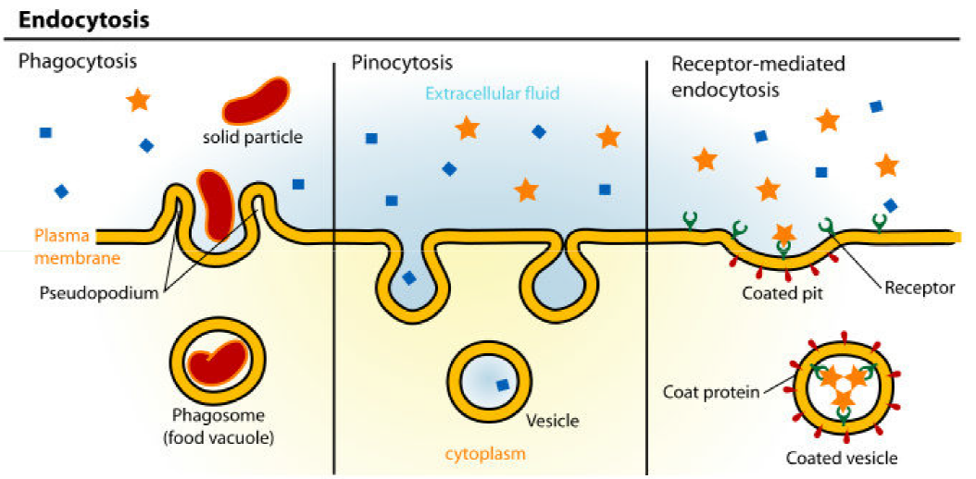
Bulk Transport Visual Summary

Slide 24
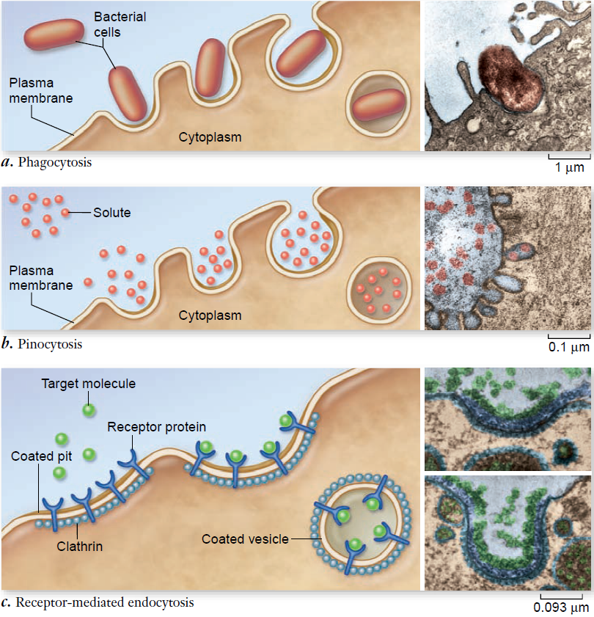
General review of endocytosis
from Raven Biology

Slide 25
Reading (Sources)
Becker's WotC: pp 341-355
Raven: Chap 5.6
Marieb: pp 79-81

Slide 26
Crossing the Membrane Comparison
Property | Passive Diffusion | Facilitated Diffusion | Active Transport | Co-Transport
specific membrane protein required | no | yes | yes | yes
solute transported against gradient | no | no | yes | yes
coupled to ATP hydrolysis | no | no | yes | no
coupled to movement of cotransported molecule/ion down its gradient | no | no | no | yes
examples of molecules transported | O₂, CO₂, steroid hormones | glucose, amino acids, ions, water | ions, lipids, small hydrophilic molecues | glucose, amino acids, various ions sucrose
adapted from Lodish et al., eds., Molecular Cell Biology, 5th Ed
This table compares the various ways solutes move across the cell membrane

